Slide 1
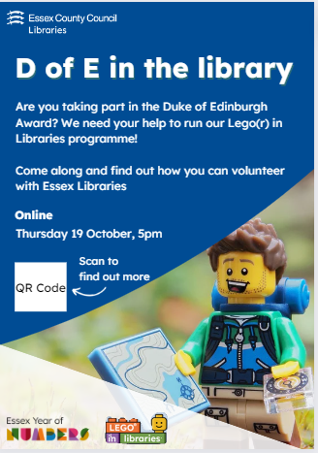
Welcome to our information presentation
Please make sure your microphone is on mute.
This meeting will be recorded.
We will begin shortly

Slide 2

Background
  "Literacy sits at the heart of the levelling up agenda.
  Improving literacy will improve the opportunities of individuals and communities. It is great to see Essex committing to these priorities and placing libraries at the heart of their strategy. Libraries are lifelong centres of literacy, creating reading communities and of vital importance to the one in 11 children from our most vulnerable communities who don’t own a single book.
  With their commitment to literacy, Essex Libraries are showing themselves to be community activists and national leaders."
  Jonathan Douglas CBE, Hon FRSL, Chief Executive, National Literacy Trust
Notes:
In early 2022 the Library released their ambitious Library plan which is based on three pillars: Literacy, Communication and Infrastructure and Communities. In my role, my main focus is obviously the literacy pillar – however bringing the library to communities is also pivotal in my goal to raise literacy levels across the county. It’s an ambitious plan, with bringing libraries to the heart of the community being one of it’s key aims – so partnership with other areas of the council is crucial to the success of the plan.

Slide 3




Notes:
The funders – all happy to support to ensure smooth running and success of the programme

Slide 4
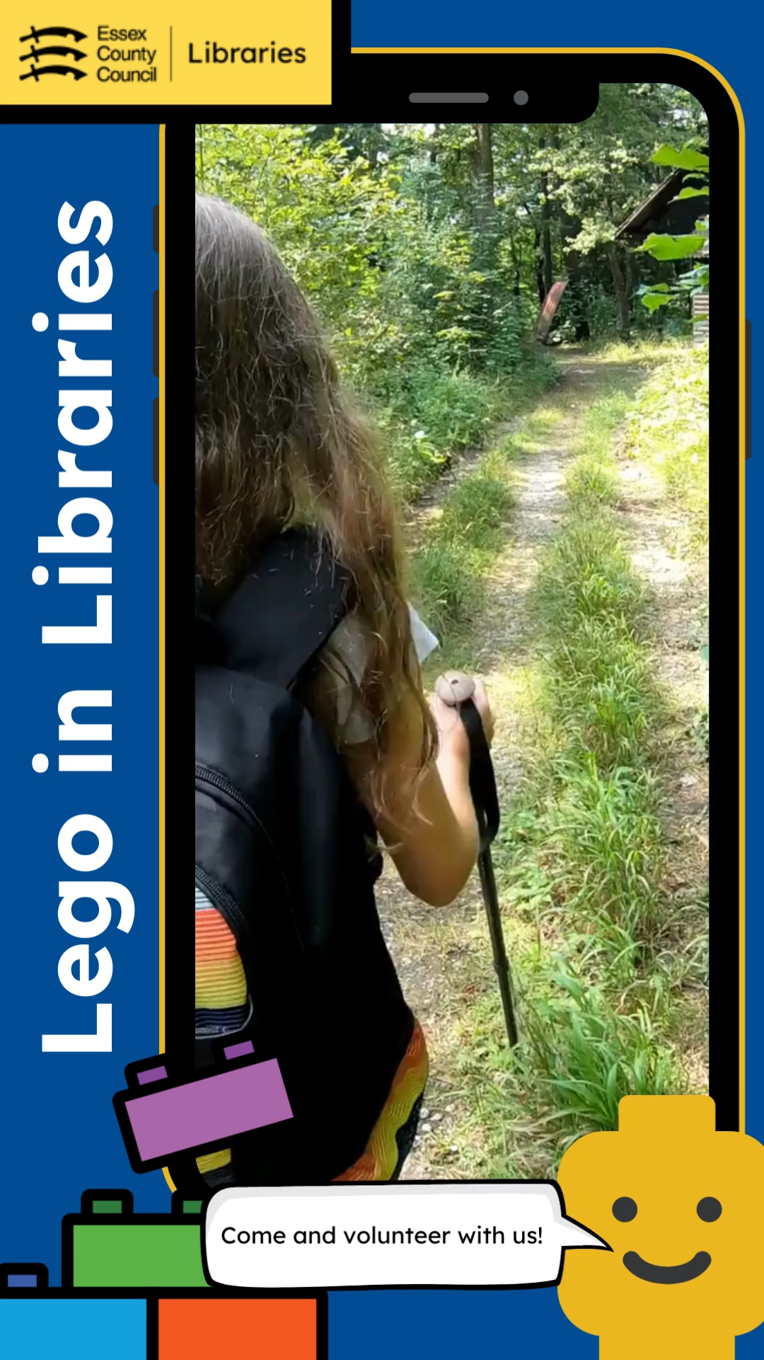
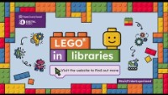
What is Lego in Libraries?

Slide 5
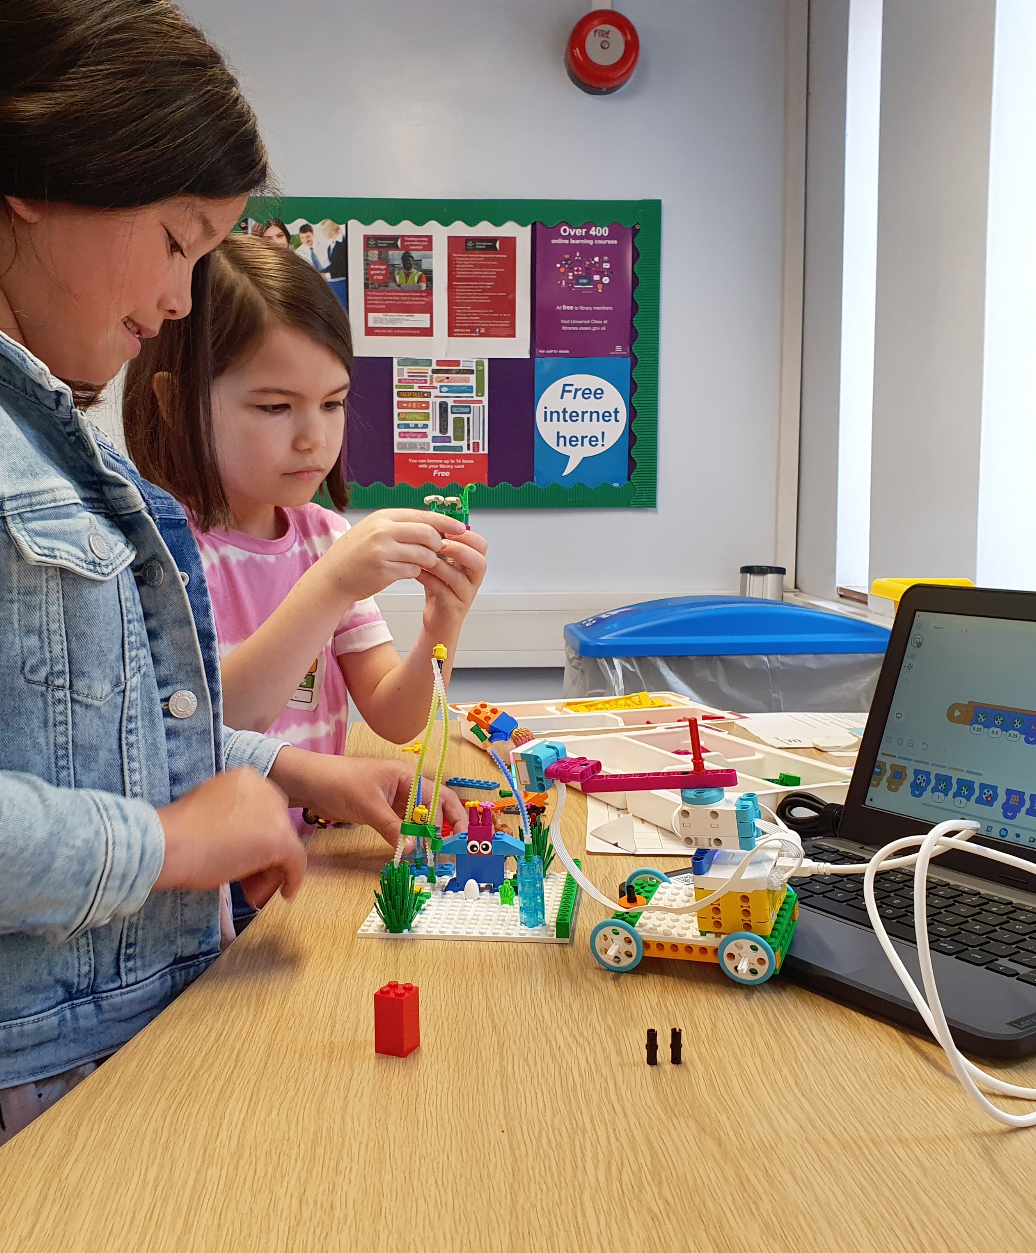
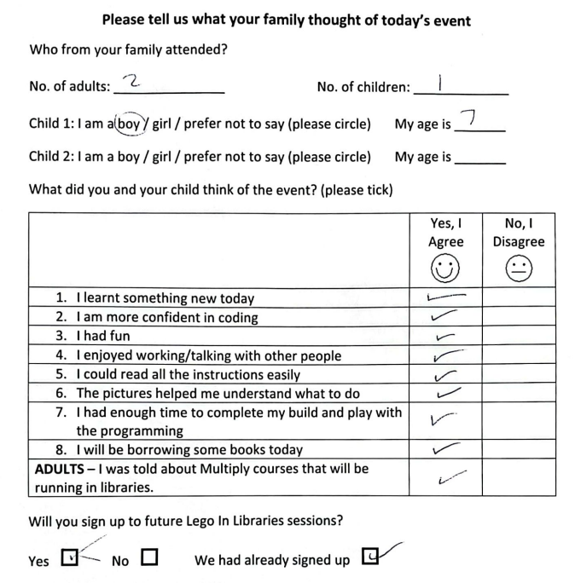
Customer Feedback
Notes:
Customer feedback has been really positive. These two girls didn’t know each other, but worked and played together beautifully during the session.

Slide 6
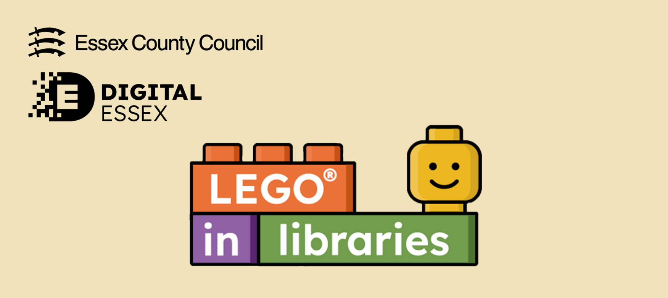
Evaluations that were completed | Age 5 | Age 6 | Age 7 | Age 8 | Age 9 | Age 10 | Age 11 | Total
 | 1 | 7 | 9 | 6 | 7 | 5 | 3 | 38
The sessions have been fantastic, and we would love to see it continue in some form or another. I would love to be able to buy a coffee during though :)
Such a great thing for children. Thank you!
I think that this has been an excellent course. My son has thoroughly enjoyed it. I think it’s a great chance to have quality time with our children. We have looked into purchasing a kit ourselves but unfortunately way out of budget. We would love to come along if held again. Many thanks :)
My daughter loves Lego, but has never done any kind of coding or created anything with motors/gears etc. So this was an amazing experience for her and has spurred her on to join a coding club at her school. We loved working on the projects together and I really enjoyed seeing what she created. Thank you again, this was an excellent opportunity.
We have enjoyed this a lot. They already love Lego both worked together. They would enjoy more but with breaks as well as more than 6 in a row is a challenge for me.
Thank you very much for the LEGO event. It was amazing. We would love to continue please :)
It would be better with a mouse
Jazmin the library assistant was extremely helpful, kind, caring soul. Really good with the children an absolute natural :)
Jaz was extremely helpful the children enjoyed her company
Such as shame the laptops broke before the end of the course. The tutor running the course was very friendly and engaging with all the children. Thank you for running the course, my children really enjoyed it.
Lego® in Libraries was purchased with support from Digital Essex and Multiply. It was funded with the intention of running in 9 libraires, mainly in Levelling Up areas. The aim was to support 90 children over a period of 6 weeks, evaluating the success of the programme after this time.
Of the families that had completed the evaluations:
63% had attended between 5-6 sessions
29% had attended between 3-4 sessions
8% had attended between 1-2 sessions
96% felt more confident in coding
87% felt more confident in reading instructions
96% said that their child showed improved skills in computing as a result of the sessions.
80% said that they had noticed an improvement in their child’s reading skills as a result of the sessions.
100% said that their child had become more confident because of the sessions.
62% of adults present said that they would like an activity for them to complete while their child takes part in the session.
100% enjoyed working with/talking to others
91% would like to continue to attend Lego® in Libraries sessions
Notes:
Here is the overall feedback from the first term of sessions. As you can see – really positive comments!

Slide 7
Jo Powell
Notes:
An example of the certificate that the children will receive on completion.

Slide 8
Coming soon…
Canvey Island
Clacton
Greenstead
Harlow
Harwich
Kelvedon
Laindon
Sible Hedingham
Walton
Shenfield Library
Stock Library
Epping Library
Maldon Library
Rochford Library
Dunmow Library
Notes:
These are all the libraries that currently have or are planning on receiving Lego. If your local library is not listed here that is not a problem, as we can always move some sets around.

Slide 9
What will you get by taking part?
In-person training in how to use the kits
Monthly drop-in support
Support network of volunteers
Extra resources to support your sessions
Confidence
A sense of achievement
Once a week for a minimum of 12 weeks
45 minutes -1 hour in length

Slide 10

Any Questions?
Joanna.Powell@essex.gov.uk

